Slide 1


Slide 2


Austin Rutledge, M. Ed., M.S. Coordinator of Instructional Design Oklahoma State University Center for Health Sciences @austinrutledge
Jessica Rucker, M.S. Ed. Coordinator of Instructional Design Oklahoma State University Center for Health Sciences @jessicaruckerID

Slide 3

Making Your Presentations More Powerful: PowerPoint Tips
October 9th, 2018

Slide 4
Our Goals
Convey the significance of designing great presentations.
Communicate the elements of a great presentation.
Provide resources to help you design and deliver great presentations.

Slide 5

Your Presentation Matters
Notes:
It’s not that lectures are ineffective, it’s “how” you lecture.
It’s not that PowerPoint slideshows aren’t worthwhile, but how they are designed and delivered.

Slide 6
Your Presentation Matters
Student Exam Question Performance
Group Description | Count | Group Score
Present and watched Panopto | 455 | 88.04%
Present and didn't watch Panopto | 489 | 83.84%
Not present and watched Panopto | 703 | 82.87%
Not present and didn't watch Panopto | 137 | 74.93%
Notes:
Research that supports efficacy of using lecture and PowerPoint as a presentation medium, as well as active learning, etc. The point is… get them in class by making class worthwhile.

Slide 7



Clear, Relevant, and Engaging Content
Know your audience
Tell them why
Convey excitement
Notes:
Convey excitement: “Personalizing makes your work come alive and helps audience members relate to it on an emotional level.”

Slide 8
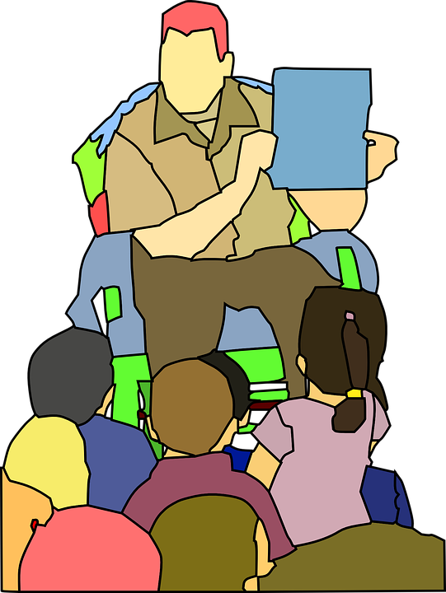

Clear, Relevant, and Engaging Content
Context
Problem
Highlights
Key points
Keep it simple and relevant
Tell your story
Notes:
Tell your story (optional in a lecture, but good when possible and good for general presentations): Storytelling is a great way to engage your learners not only by allowing them to get to know you better, but also by building meaningful connections to the content. Context refers to research- how is your story or work relevant to the overall topic, where does it fit in? (e.g., what work have others done before you, what is the background info) Identify the problem you encountered, then provide highlights of what you did and the key points learned, next steps.
Keep it simple: Avoid using a lot of jargon and acronyms. Distill your topic to its essence, focusing on the foundation, and spending less time on details that might confuse your audience. Remember, your goal is to communicate in such a way that your students will learn and understand what you are saying, so try to see it from their perspective.

Slide 9
Purposeful Design
Tables and figures should be clearly labeled and identifiable
No more than 1 slide per minute of talk
Simple Design
Strong contrast
Visuals (avoid videos)
Notes:
The ratio of slides to time talking increases as the length of the talk increases. Don’t sacrifice enriching your content because of time limitations (less is more).
No red-green combinations, no red letters on a blue background, avoid busy backgrounds.
Graphics direct attention (arrows)
Be consistent with style, unless a difference is to imply importance or engage, not distract (like if I used one different colored arrow)

Slide 10
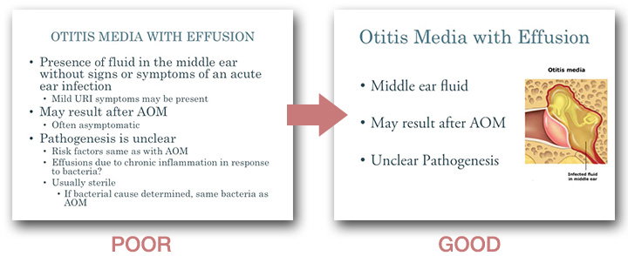
(UCSF, 2018)
Notes:
Poor: Information is organized into a hierarchy, but contains excessive text. Student is inclined to read text at pace of instructor. There is nothing of visual interest.
Good: Only main points in text. Student can focus on listening as instructor discusses each point in more detail. White space gives eye a place to rest, while image adds context.

Slide 11
Purposeful Design
Use sans serif fonts
Times New Roman
Font sizes:
Headlines: 28-40
Text: 18-28
References: 12-14
Text Rules
3-5 lines of text
Notes:
No bullet points? “Focus on verbally communicating the details. As you go through the above process for each slide, ask yourself: is the text essential to comprehending the learning objectives?”
Normal or bold fonts read easier, underlines might signify hyperlinks, italics are often hard to read on screen. All capitals are hard to read. Stay consistent with fonts (don’t change mid-talk). Better to emphasize with colors.
No red-green combinations, no red letters on a blue background, avoid busy backgrounds.
Graphics direct attention (arrows)
Be consistent with style, unless a difference is to imply importance or engage, not distract (like if I used one different colored arrow)
Self-evident rule- slide should not need explanation.

Slide 12
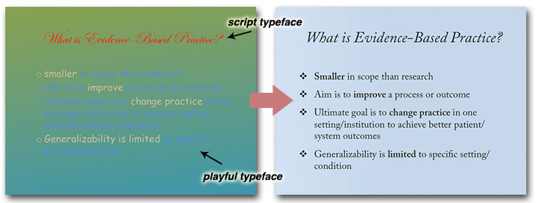
(UCSF, 2018)
Notes:
Poor: Script typefaces are difficult to read. Playful typefaces are unprofessional. A low-contrast gradient in the background also makes text difficult to read, and is distracting. Too many colors (5!) compete for attention.
Good: Regular and italic versions of the same typeface are used. The black text shows high contrast against the faintly colored background. Significant spacing between the bullet points helps differentiate them.

Slide 13
Effective Delivery
“Good teaching is one-fourth preparation and three-fourths theater.”
Gail Godwin

Slide 14
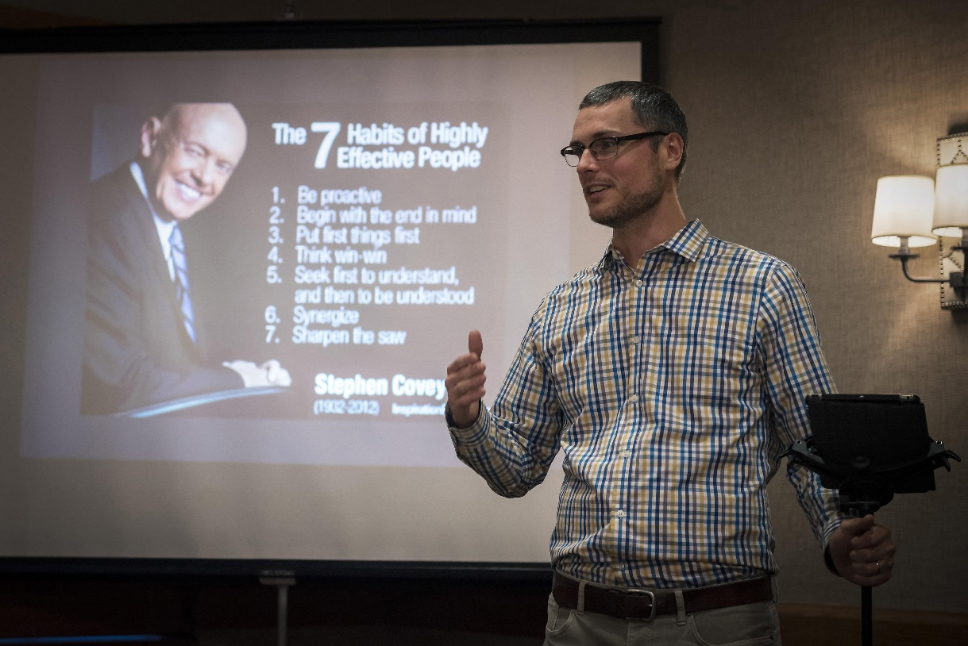
Effective Delivery
Eye contact, not reading from slides
Emphasize key points, use voice modulation
Notes:
Prepare in advance, practice, and gather peer input
Chunk in 10-15 minute increments

Slide 15


Tip #1 – Chunking
Making Your Presentation More Powerful: PowerPoint Tips
Importance (slides 5-6)
processing activities every 15-20 minutes
Content (slides 7-8)
think-pair-share
audience response purposeful reflection quick quiz…
Design (slides 9-12)
Delivery (slides 13-14)
Tips
unchunked
chunked
Notes:
Chunking Image & processing activity (high tech or low tech) examples

Slide 16
Tip #2 – Transitions and Animations
< = >
Less is more.
Notes:
Create OSU ppt template
But be careful! Mix-it up from time to time? Use similar styles.

Slide 17
Tip #3 – Keep Your Style Consistent
SlidesCarnival.com
PowerPoint Template Search
Notes:
Create OSU ppt template
But be careful! Mix-it up from time to time? Use similar styles.

Slide 18
Bonus Tip! – OSU-CHS Template
Notes:
Create OSU ppt template
But be careful! Mix-it up from time to time? Use similar styles.

Slide 19
Our Goals
Questions?
Convey the significance of designing great presentations.
Communicate the elements of a great presentation.
Provide resources to help you design and deliver great presentations.
For further questions, feel free to email us at austin.rutledge@okstate.edu or jessica.lacson@okstate.edu.

Slide 20
References
Larkin, M. (2015). How to give a dynamic scientific presentation. Elsevier Connect. Retrieved from
https://www.elsevier.com/connect/how-to-give-a-dynamic-scientific-presentation
The University of California San Francisco. (2018). Designing PowerPoint slides. Retrieved from https://meded.ucsf.edu/tee/slides#Incorporating-Animations
Flacker, J. M., Manning, K. D., & Baumgarten, D. (n.d). Making a great PowerPoint presentation [PDF document]. Retrieved from http://medicine.emory.edu/documents/research/research-greatPPT.pdf
Sutton, P. (n.d.). The art of lecturing [PowerPoint slides]. Retrieved from http://depts.washington.edu/flworien/documents/sutton_09.pptx

Slide 21
Up Next:
Keeping your Audience Active: Learning Strategies
October 23rd, 2018
Dawn Ballard, M.S.
Justin Zumwalt
Office of Educational Development
@oedchs

